Slide 1
Agenda Cisco Data Virtualization PDTool Training PDTool Studio Version Control
Notes:
Hello, and welcome to the PDTool Training course for Cisco Information Server, or CIS.

Slide 2
Topics
Basic Information
Topologies
Details
Advanced
Notes:
We begin this module by examining the basic concepts of PDTool and how it will be used.

Slide 3
PDTool License
(c) 2014 Cisco and/or its affiliates. All rights reserved.
This software is released under the Eclipse Public License. The details can be found in the file LICENSE. Any dependent libraries supplied by third parties are provided under their own open source licenses as described in their own LICENSE files, generally named .LICENSE.txt. The libraries supplied by Cisco as part of the Composite Information Server/Cisco Data Virtualization Server, particularly csadmin-XXXX.jar, csarchive-XXXX.jar, csbase-XXXX.jar, csclient-XXXX.jar, cscommon-XXXX.jar, csext-XXXX.jar, csjdbc-XXXX.jar, csserverutil-XXXX.jar, csserver-XXXX.jar, cswebapi-XXXX.jar, and customproc-XXXX.jar (where -XXXX is an optional version number) are provided as a convenience, but are covered under the licensing for the Composite Information Server/Cisco Data Virtualization Server. They cannot be used in any way except through a valid license for that product.
This software is released AS-IS!. Support for this software is not covered by standard maintenance agreements with Cisco. Any support for this software by Cisco would be covered by paid consulting agreements, and would be billable work.

Slide 4
Basic Information
Notes:
Next, let’s examine some common deployment options for CIS.

Slide 5
PDTool Studio Basic Information
PDTool Studio VCS Support
Subversion
Microsoft Team Foundation Server (TFS) 2010 – 2013 (TEE 11.0 required)
Perforce
CVS
PDTool Studio Version Control Operations
Check-in – provides the ability to check-in individual CIS resources from CIS into a VCS using Composite Studio.
Check-out – provides the ability to check-out CIS resources from VCS using CIS Studio.

Slide 6
Version Control Benefits
Robust development process
Project evolution management
Change tracking
Checkpoints
Backtracking
Restore accidental deletion
Project scalability support
Distributed team development
Controlled resource sharing

Slide 7
Topologies
Notes:
Next, let’s examine some common deployment options for CIS.

Slide 8

VCS Topology Basic Concept
PDTool Studio provides a bridge between CIS Studio and VCS Repository
Diff/Merger
CIS Studio
CIS Studio VCS Operation
Workspace initialized on each client computer
Determine difference between VCS and CIS resources
Supported VCS repository and client software [svn, tf.cmd, p4, cvs]
Notes:
CIS Repository is the master in this scenario because it is always the most current version of the CIS objects. It is different than what most developers are used. When it comes to version control most developers think of the VCS as the master repository and their file system as the local development workspace. However, with CIS Studio it is connected live with the CIS repository and any modifications to the code are immediately available to all CIS Studio developers. The VCS repository servers as the slave. It’s purpose in life provides the following functions:
Provides a record of releases
Provides a staging area to deploy releases to a target CIS server
Provides a backup of resources on an individual basis so that if resource(s) are accidently deleted, it is possible to retrieve individual resources.
Provides a facility to perform a difference between releases and report on changes.
What it does no provide:
CIS Studio does not provide a graphical interface like Eclipse to merge differences in code.
CIS does not provide its own versioning and therefore can only contain the latest version of code at any given point in time.

Slide 9

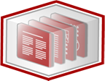


VCS Topologies (Single-Node)
Single-Node Topology
CIS Studio Resource Definition
Check In
Write
Check Out
Read
VCS Repository
CIS Studio
CIS Repository
Notes:
CIS Studio and CIS Repository reside on the same machine and communicate with a VCS Repository either locally to the machine or remotely.

Slide 10
VCS Topologies (Multi-Node)
Multi-Node Topology
CIS Studio Resource Definition
Write
CIS Studio Resource Definition
Read
CIS Repository
CIS Studio
Check In
Write
Check Out
Read
VCS Repository
CIS Studio
CIS Repository
Write
Read
CIS Studio Resource Definition
CIS Repository
CIS Studio
Notes:
There are multiple CIS users each having CIS Studio and CIS Repository reside on their machine. Each user communicates remotely to a VCS Repository. This is not an ideal scenario as there can be collisions on code being checked in. This requires a high degree of developer coordination.

Slide 11
VCS Topologies (Multi-User Direct)
Multi-User Topology (Direct VCS Access)
CIS Studio Resource Definition
Read
Check In
Write
Check Out
CIS Studio
CIS Studio Resource Definition
Read
Check In
Write
Check Out
CIS Repository
CIS Studio
VCS Repository
CIS Studio Resource Definition
Read
Check In
Write
Check Out
CIS Studio
Notes:
The multi-user direct scenario is more typical of the CIS user base. This represents a shared CIS environment where the developers have CIS Studio on their machine. In this scenario each developer also has PDTool Studio installed to provide the bridge between CIS Studio and the VCS repository.

Slide 12
VCS Topologies (Multi-User Managed)
Multi-User Topology (Managed VCS Access)
CIS Studio Resource Definition
Read
Check In
Write
Check Out
CIS Studio
CIS Studio Resource Definition
Read
Write
CIS Repository
CIS Studio
VCS Repository
CIS Studio Resource Definition
Read
Write
CIS Studio
Notes:
The multi-user managed scenario is a derivation on the “direct” approach where the responsibility of check-in/check-out falls to a small group of development release managers. They are responsible for checking in code at release time.

Slide 13
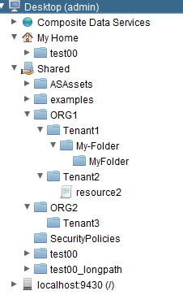
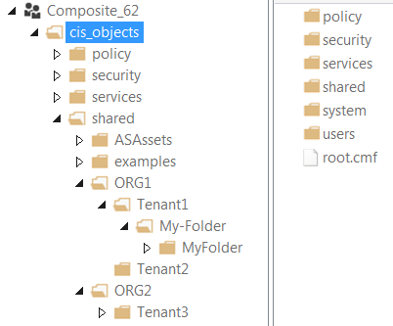
VCS Topologies (Multi-Tenant)
Multi-Tenant VCS Topology
CIS Studio Resource Definition
Read
PDTool Studio scripts
/PDToolStudio62
/SVNsw (subversion workspace)
/TFSsw (TFS workspace)
Write
CIS Studio (Tenant 1)
Check In
Check Out
VCS Repository
TFS, Subversion…
CIS Studio Resource Definition
Read
Write
CIS Repository
CIS Studio (Tenant 2)
CIS Studio Resource Definition
Read
Write
CIS Studio (Tenant 3)
Notes:
The multi-tenant topology provides for a strategy where CIS is being used by multiple tenants. The goal is to provide the flexibility where targeted CIS tenant folders are checked into the VCS repository without having to check-in the entire CIS repository. This strategy also allows the use of multiple VCS repositories of the same or different types. It allows for some tenants not to use VCS at all if they wish.

Slide 14
Details Section
Notes:
Next, let’s examine some common deployment options for CIS.

Slide 15
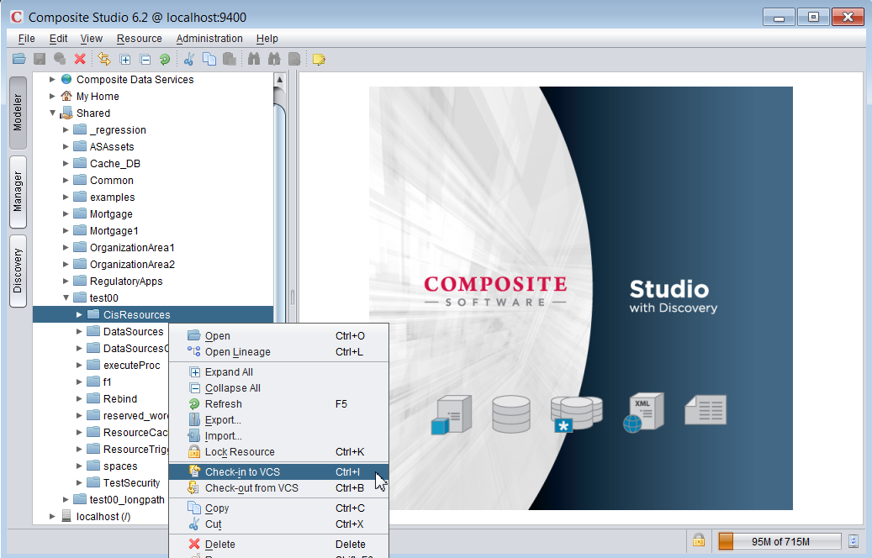
CIS Studio: Operations
Check-in
Check-out

Slide 16
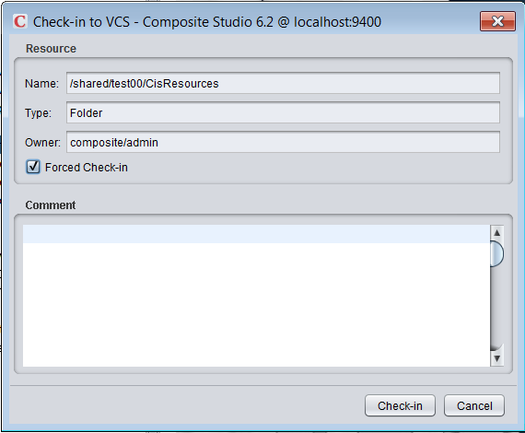
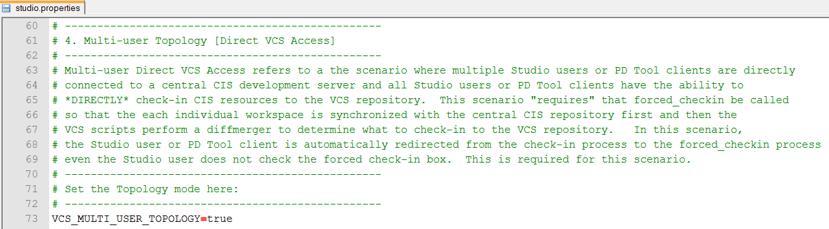
CIS Studio: Check-in
Check-in – Compare with local workspace as is without synchronizing with VCS
Forced Check-in – Force synchronization of workspace from VCS and CIS before comparing.
PDTool Studio: studio.properties variable – VCS_MULTI_USER_TOPOLOGY=true
Forced Check-in box is checked

Slide 17
PDTool Studio: Workspace
Workspace Concepts
Workspace – Used for checking in/out resources to/from VCS.
Resources checked out from VCS are individual .cmf files
Temporary workspace – Used for importing/exporting resources to/from a target CIS server.
Resources are exported as individual .cmf files

Slide 18
CIS Studio: Resource to VCS Mapping
CIS Resource Types CIS → VCS Mapping
Containers (Folder, Catalog, Schema) myFolder → myFolder.cmf
Data sources myDS → myDS.cmf
Definition sets myDefSet → myDefSet_defintions.cmf
Links (published services) myView → myView_link.cmf
Procedures (SQL Script, XQuery, XSLT, etc.) myProc → myProc_procedure.cmf
Tables (Relational Table, View, Flat File, etc.) myView → myView_table.cmf
Trees (XML Files) myXML → myXML_tree.cmf
Triggers myTrigger → myTrigger_trigger.cmf

Slide 19
CIS Studio: CMF Resources
CMF Files (Composite Metadata File)
XML formatted file for each resource – XML does not guarantee order
Resources with underscores –
e.g. my_resource → my__resource
Non-Alphanumeric [spaces, comma, etc.] – encoded with underscore + 4 digit hex code.
e.g. “my folder” → my_0020folder.cmf
Case insensitive files systems (windows) yields unexpected results when different resources in same CIS namespace have the same name.
*** DO NOT DO THIS WHEN USING VCS ***
CIS: Res1 [folder] and Res1 [data source] in same folder
CIS: RES1 [table] and res1 [table] in same folder (or any combination of case)

Slide 20
CIS Studio: CMF Resource Content
Identification (name, type, version)
Interface (input types, output types)
Constraints (identity, referential)
Implementation (body, definition)
Dependencies
Validation assessment
Configuration settings
Security settings
Caching settings
Statistics settings
Studio model
User-defined annotation

Slide 21
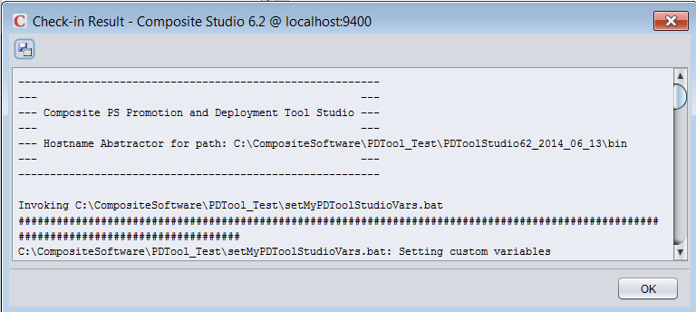
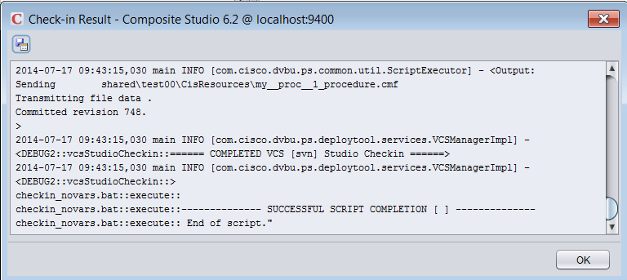
PDTool Studio: Logs
Logs
PDToolStudio62/logs
app.log – provides a rolling log of executions
Top of the Pop-up Log
Bottom of the Pop-up Log

Slide 22
CIS Resources That Don’t Get Checked In
Studio resources
Not amenable to versioning
Built-in (e.g. /lib, /services/databases/system)
Non-Studio resources
Connectors
Stored under /system/connector/…
Server configuration files
Binary files
CJP jars, DB driver jars, …

Slide 23
CIS Studio: Security
Check-in and checkout processes are CIS security sensitive
CIS authentication required
CIS authorization rules applied
Check-in by a certain CIS user applies only to those CIS resources that are read-accessible by that user
Check-out by a certain CIS user may be performed if all the resources being checked out are write-accessible by that user

Slide 24
Advanced Section
Notes:
Next, let’s examine some advanced topics.

Slide 25
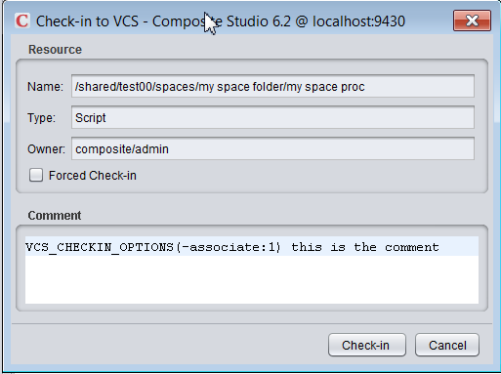
PDTool Studio: Check-In Options
Required Check-in commands
Added into PDTool Studio check-in comments
VCS_CHECKIN_OPTIONS(vcs-command)
E.g. “VCS_CHECKIN_OPTIONS(-associate:1) check-in comment”
This example shows how to infuse a TFS command which associates a work item task id with check-in of some code.

Slide 26
PDTool Studio: Multiple CIS Server Support
Supports multiple CIS servers from the same installation
Scenario 1 – Same CIS server using multiple VCS
A developer who is working on different projects in a shared CIS server and needs to check-in code for one project into one VCS (e.g. subversion) and also check-in code for another project into a different VCS (e.g. TFS).
Scenario 2 – Different CIS servers using same or multiple VCS
A developer who is working on the primary development server and needs to check-in code to VCS. The same developer is working on a “maintenance” CIS server and needs to check-out and check-in code to a different VCS branch.

Slide 27
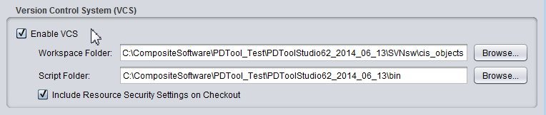
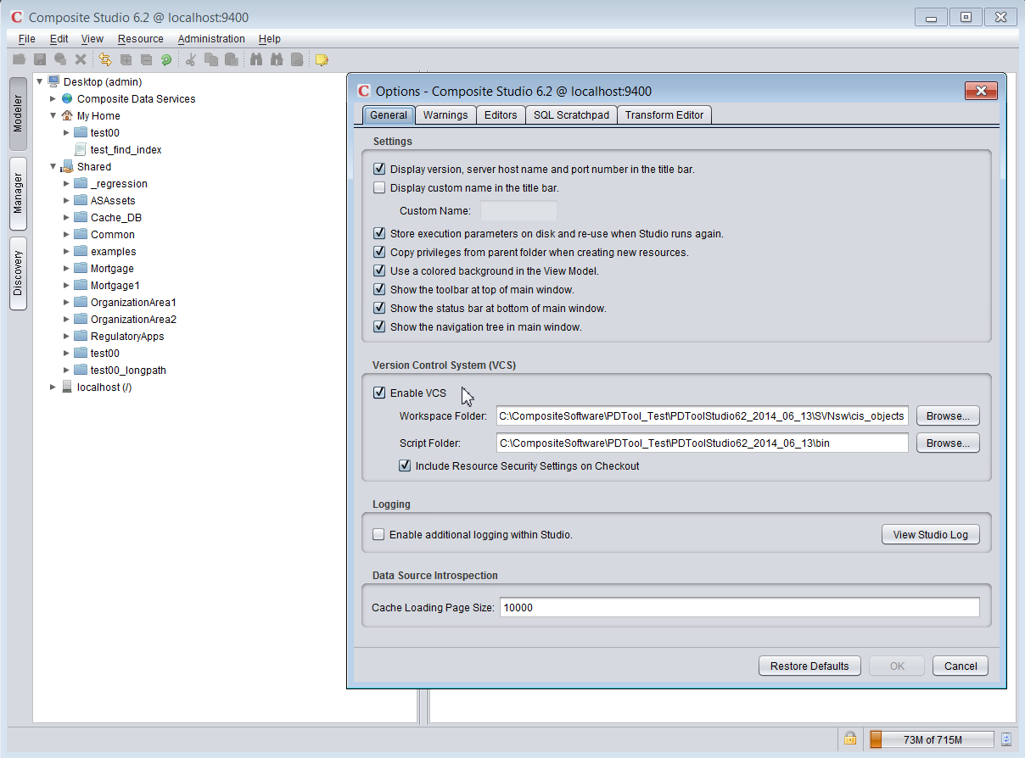
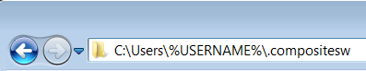

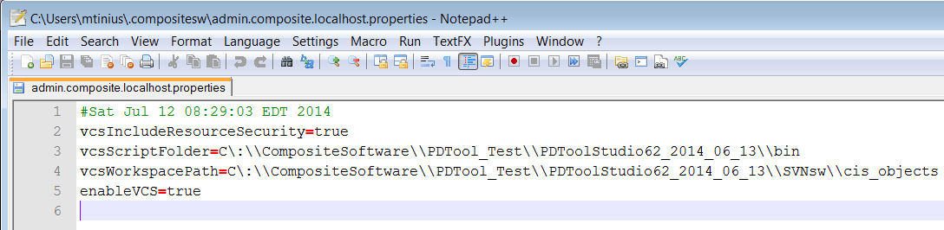
CIS Studio: Configure Multiple CIS Servers
CIS Login: user=admin, domain=composite, host=localhost
CIS Studio → Edit → Options
Saved as C:\Users\%USERNAME%\.compositesw\USER.DOMAIN.HOST.properties

Slide 28
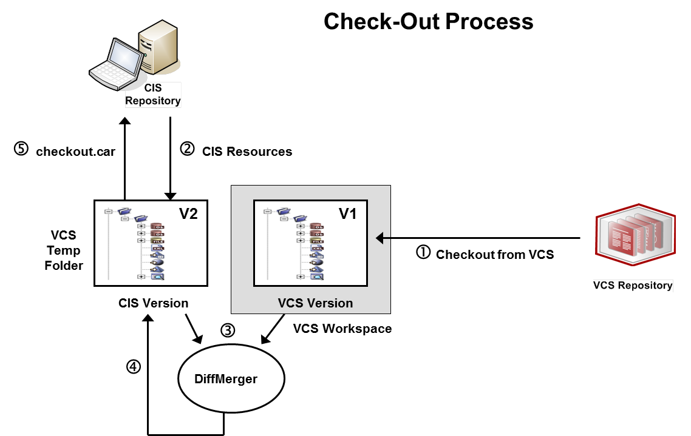
PDTool Studio: Check-out
PDTool Studio Version Control Check-out Operation
Notes:
The check-out process shown in the illustration involves these steps:
A current snapshot of the specified CIS resources is obtained from the VCS workspace (V1).
The current version of the same resource subtree in CIS is captured into the VCS temp folder (V2).
The DiffMerger batch script is applied against the CIS and VCS versions to compute V1-V2. V1-V2 captures the required modifications (that is resource creations, updates or deletions) required to convert subtree V2 into V1.
The DiffMerger batch script is applied to V2, using as input V1 and V1-V2, to modify the contents of subtree V2, so that they match the contents of V1 and package all resource changes in a checkout.car file.
The checkout.car file is imported into CIS repository.
The VCS Workspace is cleaned up; V2, the checkout.car file, and the V1-V2 results are deleted.

Slide 29
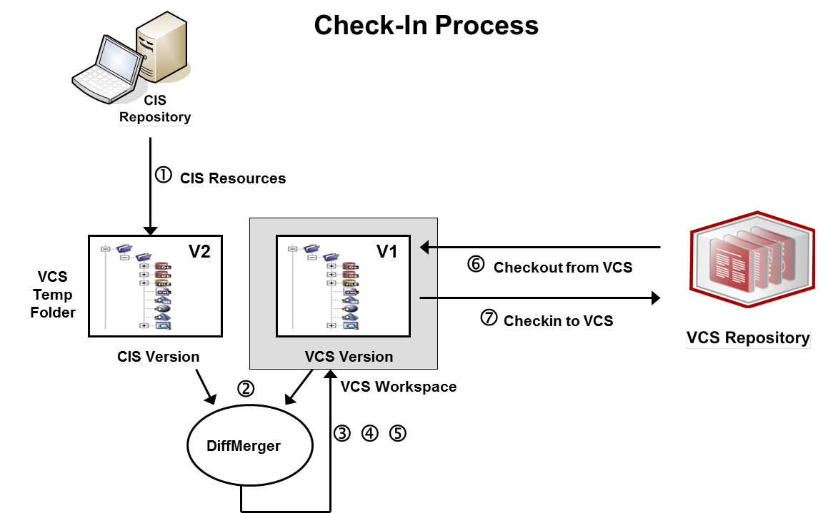
PDTool Studio: Check-in
PDTool Studio Version Control Check-in Operation
Notes:
The check-in process shown in the illustration involves these steps:
The current version of the same resource subtree in CIS is captured into the VCS temp folder (V2).
The DiffMerger batch script is applied against the CIS and VCS versions to compute V2-V1. V2-V1 captures the required modifications (that is resource creations, updates or deletions) required to convert subtree V1 into V2.
The VCS-specific pre-processor in the Lifecycle Listener is applied on V1, using as input V2 and V2-V1, to prepare the workspace V1 for the application of the modifications described in V2-V1.
The DiffMerger batch script is applied to V1, using as input V2 and V2-V1, to modify the contents of workspace V1, so that they match the contents of V2.
The VCS-specific post-processor in the Lifecycle Listener is applied on V1, using as input V2 and V2-V1, to prepare the workspace V1 for checking into the VCS.
A current snapshot of the specified CIS resources is obtained from the VCS workspace (V1).
V1 is checked into the VCS.
V2 and V2-V1 are deleted.

Slide 30
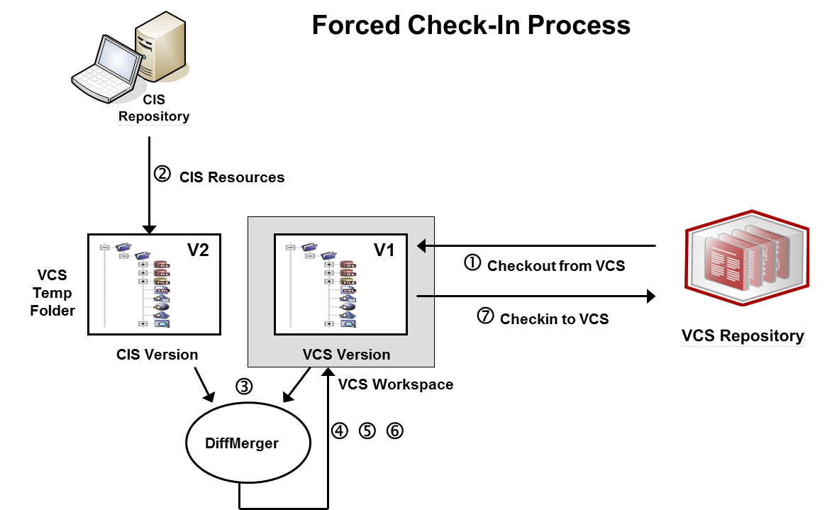
PDTool Studio: Forced Check-in
PDTool Studio Version Control Forced Check-in Operation
Notes:
The check-in process shown in the illustration involves these steps:
The check-in process shown in the illustration involves these steps:
A current snapshot of the specified CIS resources is obtained from the VCS workspace (V1).
The current version of the same resource subtree in CIS is captured into the VCS temp folder (V2).
The DiffMerger batch script is applied against the CIS and VCS versions to compute V2-V1. V2-V1 captures the required modifications (that is resource creations, updates or deletions) required to convert subtree V1 into V2.
The VCS-specific pre-processor in the Lifecycle Listener is applied on V1, using as input V2 and V2-V1, to prepare the workspace V1 for the application of the modifications described in V2-V1.
The DiffMerger batch script is applied to V1, using as input V2 and V2-V1, to modify the contents of workspace V1, so that they match the contents of V2.
The VCS-specific post-processor in the Lifecycle Listener is applied on V1, using as input V2 and V2-V1, to prepare the workspace V1 for checking into the VCS.
V1 is checked into the VCS.
V2 and V2-V1 are deleted.

Slide 31
Q&A

Slide 32
TOMORROW starts here.

Slide 33
Extra slides

Slide 34
PD Tool Studio VCS Configuration Process
1
Prepare VCS Repository (admin)
Install
PD Tool for Studio
2
3
Configure VCS Environment Properties
VCS specific
4.1
Initialize VCS Workspace
4.2
Initialize VCS Base Folders (admin)
Enable
VCS in Studio
5
6
Test VCS
Notes:
Prepare VCS Repository – an administrator uses native VCS tools to create a “repo” for CIS to check-in resources.
Install PDTool Studio – install according to installation instructions
VCS command line utility must be installed on same machine.
Configure VCS Environment Properties – properties may be configured in one or all of environment batch files, studio configuration property files.
4.1 Initialize VCS Workspace – executing VCS Init initializes the local workspace with what is in the VCS system. This is a pre-requisite to using VCS.
4.2 Initialize VCS Base Folders – this is a one-time, optional operation performed by an admin in a multi-tenant environment where only certain folders will be checked in under version control. This alleviates having to check-in the entire CIS repository which could be quite large.
5. Enable VCS in Studio – enable VCS using the “Edit, Options” menu. This pop-up window provides a way to configure where the workspace folder and PDTool script folder is located.
7. Test VCS – test check-in, check-out and forced check-in capabilities from studio on a single resource and then on a folder with a small number of resources.

Slide 35
TOMORROW starts here.

